Slide 1
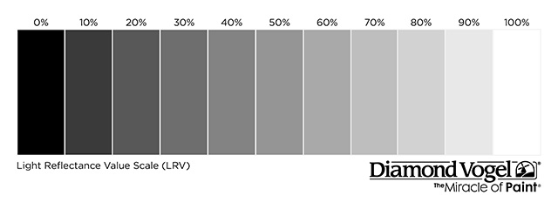
Away Team Jerseys Gray Color Spectrum Chart
100% 90% 80% 70% 60% 50% 40% 30% 20% 10% 0%
Notes:
Comment on Slide:
The NFHS has decided that beginning in 2021 in Basketball, for the color gray and/or any other light colors being used for an away jersey, it cannot go below 70% shading of the main color being used in order for it to clearly contrast with white.

